Slide 1


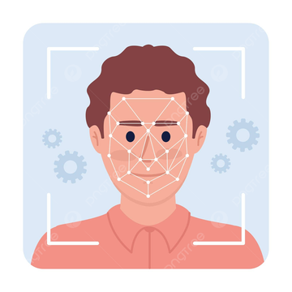
Deep Fake Detection System
"The Shield Against Digital Deception."
SIC 701 Ai Team 17

Slide 2
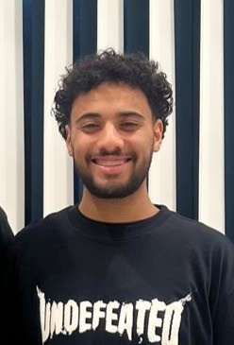
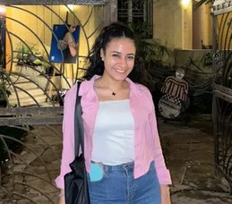



About Us:
Faris Ahmed
Yara Harby
Ahmed Kamal
Under Supervision:
Eng: Aya Nada
Samsung Innovation Campus

Slide 3

Agenda
Introduction
Problem Statement and Technical Foundation
Pipeline Explanation
Key Tasks
Results and Insights
Deployment and Optimization
Conclusion and Future Work
Q & A
Samsung Innovation Campus

Slide 4

Introduction

Slide 5


Project 3
Graduation Project
Introduction
Deepfakes—synthetic media created via advanced generative models—pose a critical and growing threat to information integrity and public trust.
The technology is rapidly advancing, making detection increasingly difficult for both human perception and traditional algorithms.
Samsung Innovation Campus

Slide 6
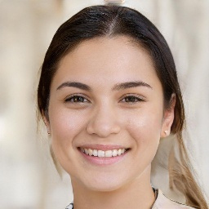

Project 3
Graduation Project
Fake
Real
Samsung Innovation Campus

Slide 7
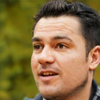













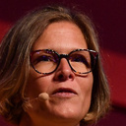

Project 3
Graduation Project
Fake
Real
Samsung Innovation Campus

Slide 8
Problem Statement

Slide 9
Project 3
Graduation Project
Problem Statement
Social media platforms are full of AI-generated faces, bot accounts, and impersonations.
Many fake profiles look realistic, and most users cannot distinguish between real and fabricated accounts.
Samsung Innovation Campus

Slide 10
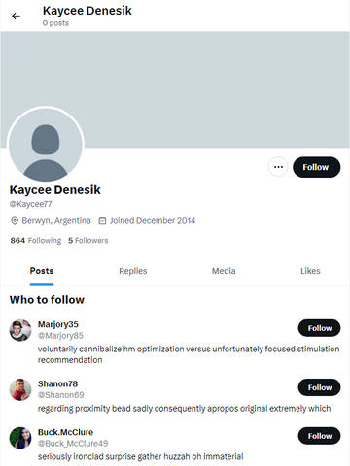
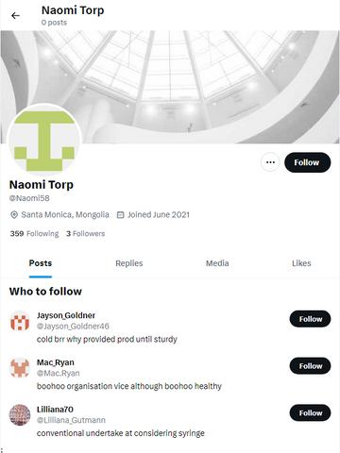
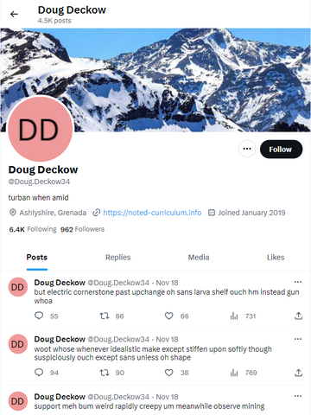
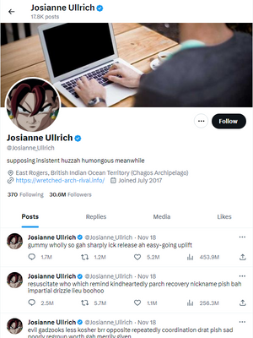
Project 3
Graduation Project
Bot
Cyborg
Real
Verified
Samsung Innovation Campus

Slide 11

Project 3
Graduation Project
Project Goal
The goal of this project is to build an intelligent system that detects fake accounts on X (Twitter) by analyzing both profile images and posted media.
Our system uses AI models to determine whether a profile picture or posted image is real, AI-generated, stolen, or manipulated and identify whether an account is likely real, fake, or bot-controlled.
"The Shield Against Digital Deception”.
Samsung Innovation Campus

Slide 12
Project 3
Graduation Project
This Enables
Improving platform safety and authenticity
Reducing the spread of misinformation
Supporting moderation teams with automated detection tools
Enhancing trust in online communities by identifying suspicious or non-human accounts

Slide 13

Challenges and Technical Foundation

Slide 14
Project 3
Graduation Project
Deefake Detection Challenges
Deepfakes are designed to be visually convincing, with forgery evidence often contained in high-frequency noise patterns and latent inconsistencies within the image.
Training a complex deep learning model from scratch is computationally expensive and data-intensive for this specialized task.
Samsung Innovation Campus

Slide 15

Project 3
Graduation Project
Our Solution: Transfer Learning
We utilize Transfer Learning to leverage the vast feature knowledge acquired by ResNet50 on the ImageNet dataset.
This approach drastically reduces training time, data requirements, and computational cost while ensuring powerful feature extraction.
Samsung Innovation Campus

Slide 16
Project 3
Graduation Project
x_fake_profile_detection Challenges
Imbalanced data (Cyborg class was rare)
Generalization Limitation (this model trained only on X data)
Samsung Innovation Campus

Slide 17
Project 3
Graduation Project
Our Solution: Transfer Learning
The dataset was prepared to be balanced across all four categories (BOT, CYBORG, REAL, VERIFIED).
Each category in the training and test sets contains an equal number of samples (2,500 samples per category in the test set, and 10,000 samples in the training set, distributed equally).
Combination of Generated and Real Data
The documentation indicates that the collection was created using "generated accounts and real accounts on X." This suggests that they used data generation or Data Synthesis techniques to ensure a sufficient number of samples for categories that might be rare in reality (such as Cyborgs) in order to achieve the required balance.

Slide 18

Pipeline Explanation

Slide 19
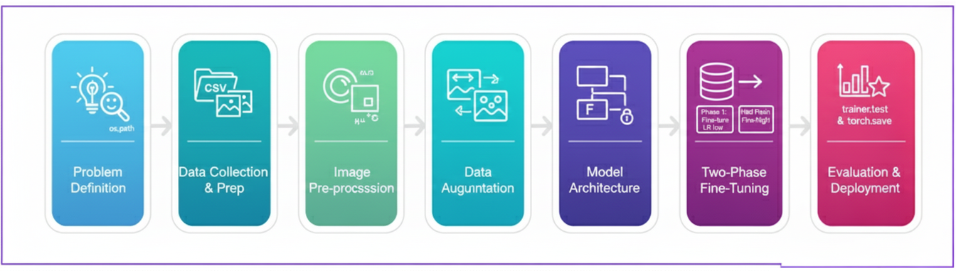
Project 3
Graduation Project

Slide 20

Methodology and Tools

Slide 21

Project 3
Graduation Project
Core Framework and Architecture
We chose PyTorch Lightning for research standardization, structured training loops, and seamless GPU scaling.
The timm library provided a standardized interface for loading our pre-trained ResNet50 backbone.
Backbone: ResNet50 (Pre-trained on ImageNet).
Head: New 2-class Linear Classifier (Real vs. Fake).

Slide 22
Project 3
Graduation Project
We used the pretrained model x-bot-profile-detection (from HuggingFace).
This model is built on top of SigLIP2 (specifically the “google/siglip2-base-patch16-224” checkpoint)
It classifies profile images into four categories: bot, cyborg, real, or verified.
Using a pretrained, well-tuned model speeds up development, reduces need for large training data, and leverages strong visual features learned from large-scale vision-language pretraining.

Slide 23
Key Tasks - Two-Phase Fine-Tuning Schedule

Slide 24
Project 3
Graduation Project
Phase 1: Head Adaptation (Feature Extractor):
The ResNet50 Backbone is frozen (parameters untrainable).
Standard rate of LR=10^-4 for rapid head convergence.
Typically runs for a fixed number of epochs or until EarlyStopping triggers on the validation loss.
Phase 2: Full Fine-Tuning (Model Refinement):
The Entire Model is Unfrozen (Backbone and Head are trainable).
A drastically lower rate of LR=10^-5 is used. This prevents large gradient updates from destroying the generalized ImageNet features, preventing "catastrophic forgetting."

Slide 25
The Rationale of Freezing

Slide 26
Project 3
Graduation Project
Why Freeze the Backbone?
Preservation of General Knowledge: The ImageNet weights contain low-level (edges, colors) and mid-level (textures, shapes) feature detectors. Freezing these prevents them from being immediately corrupted by large, random gradients from the new task.
Accelerated Convergence: By only training the small Classification Head, the model quickly learns to map the existing ResNet features to the new binary output space. This is much faster than training the entire network.
Overfitting Prevention

Slide 27
Results and Insights

Slide 28
Project 3
Graduation Project
Final Test Performance
ResNet50 Deep Detection Model.
Test Accuracy 92.33% Percentage of images correctly classified.
Test Loss 0.1742 Overall model error on the test set.
VGG16 Deep Detection Model.
Test Accuracy 58.26%
Test Loss 1.778

Slide 29
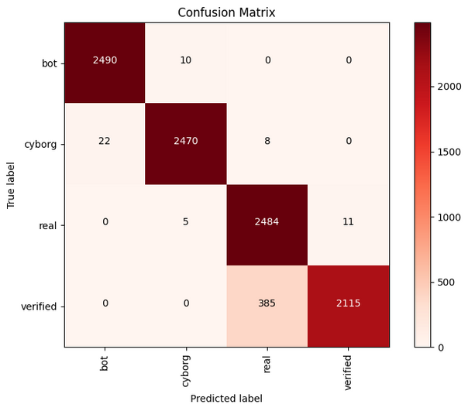
Project 3
Graduation Project
Model Performance (x-bot-profile-detection)
Classification Report:
precision recall f1-score support
bot 0.9912 0.9960 0.9936 2500
cyborg 0.9940 0.9880 0.9910 2500
real 0.8634 0.9936 0.9239 2500
verified 0.9948 0.8460 0.9144 2500
accuracy 0.9559 10000
macro avg 0.9609 0.9559 0.9557 10000
weighted avg 0.9609 0.9559 0.9557 10000

Slide 30
Deployment

Slide 31
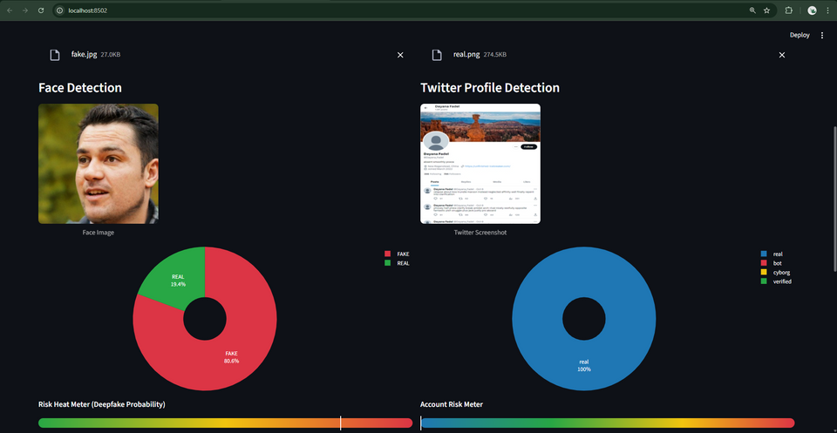
Project 3
Graduation Project
Deep Fake Detection System Deployement
Our AI models are accessible via a web application built with Streamlit.
Users can upload face images and Twitter profile screenshots to analyze account authenticity.
The deployment allows real-time predictions without programming skills.
Samsung Innovation Campus

Slide 32
Project 3
Graduation Project
User Work Flow
1. Upload face image and Twitter profile screenshot.
2. Images are preprocessed and sent to AI models.
3. Models predict class probabilities:
Face: Real / Fake
Profile: Verified / Real / Cyborg / Bot
4. Results are displayed:
Pie charts of probabilities
Risk heat meters
Explainability bullets
5. Final interpretation of account authenticity is generated.
Samsung Innovation Campus

Slide 33
Project 3
Graduation Project
Understanding Account Authenticity
1. Real / Verified Profile + Real Face
Most likely a genuine account.
Face shows no signs of deepfake artifacts.
Profile is authentic and trustworthy.
2. Real / Verified Profile + AI‑Generated / Fake Face
Real account, but user might be using AI-generated avatars.
Could indicate:
Fun with AI faces
Privacy / identity concealment
Profile is legitimate, face is synthetic.
Samsung Innovation Campus

Slide 34
Project 3
Graduation Project
Understanding Account Authenticity
3. Cyborg / Bot Profile + Real Face
Real face on a suspicious account.
Could indicate:
Stolen identity
Fan pages of celebrities
Semi-automated accounts
Requires caution; profile behavior is not fully trustworthy.
4. Cyborg / Bot Profile + AI‑Generated / Fake Face
Fully fake account.
Profile shows bot-like or automated behavior.
Face is AI-generated / deepfake.
Could be part of bot networks, spam campaigns, or malicious activity.
Samsung Innovation Campus

Slide 35

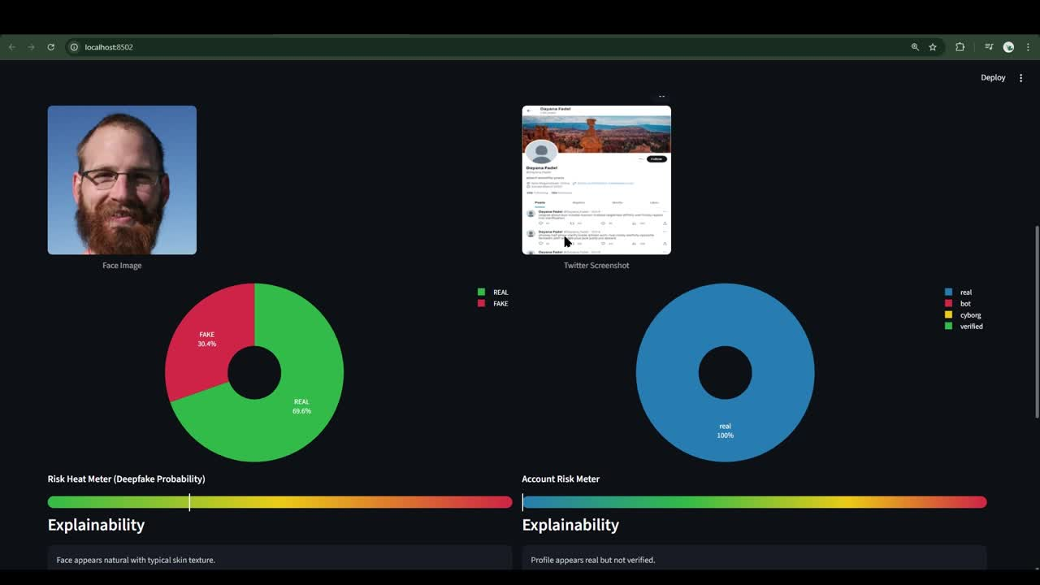

Slide 36
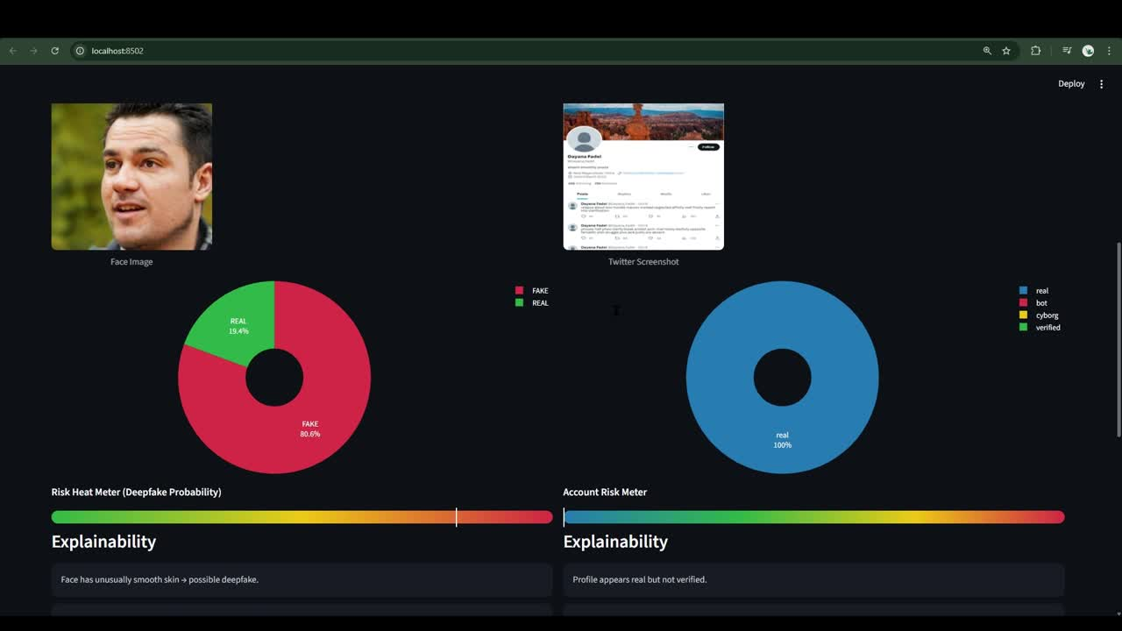

Slide 37
Future Work

Slide 38
Project 3
Graduation Project
Multi‑Platform Support
1. Expand the system beyond Twitter to analyze screenshots from:
Instagram profiles
Facebook accounts
LinkedIn
2. Each platform has unique layout patterns, so the model would be retrained to understand:
Platform-specific UI structures
Unique metadata (followers, bio, highlights)
Different behavior patterns (posting frequency, engagement)
Samsung Innovation Campus

Slide 39
Project 3
Graduation Project
Improved Deepfake Detection
Spatial Domain Features Extraction
Use a pre-trained CNN (e.g., EfficientNetV2) to capture:
High-level textures
Subtle AI artifacts in the image
Frequency Domain Features Extraction
Transform images to the frequency domain (DCT/FFT).
Detect GAN-specific noise or compression artifacts invisible in pixel space.
Feature Fusion
Combine spatial and frequency features into a single feature vector per image.
Enables richer representation for classification.
Samsung Innovation Campus

Slide 40
RESOURCES
X (Twitter Profiles Dataset)
Real Vs Fake Faces Dataset
Samsung Innovation Campus

Slide 41
Any Questions?
Samsung Innovation Campus

Slide 42
Thank You

